Slide 1
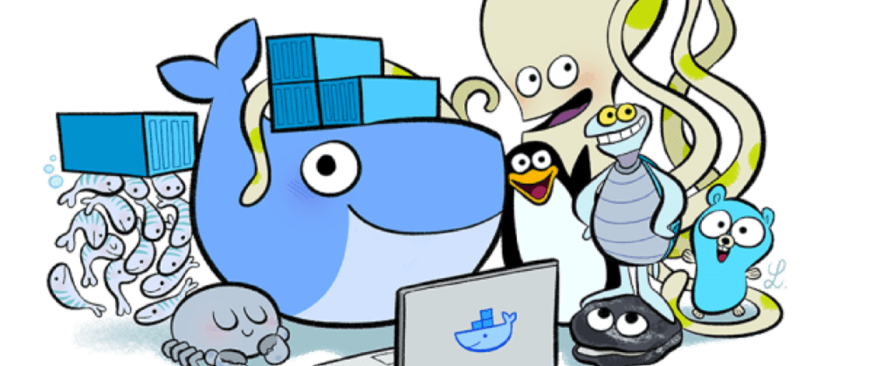
Containers 101
february 2024

Slide 2

About me
Hi, I’m Ravindu Fernando
STL @ Sysco LABS – Sri Lanka
Cloud Computing Enthusiast

Slide 3
Agenda
Brief History – Infrastructure shifts over the decades
VMs vs Containers
What are containers and what problem does it solve?
What is Docker?
Deep dive into Docker Internals
Demo

Slide 4
Brief History – Infrastructure shifts over the decades
Mainframe to PC
90’s
Baremetal to Virtual
00’s
Datacenter to Cloud
10’s
Host to Container (Serverless)
Now
Let’s Recap MAJOR INFRASTRUCTURE SHIFTS
Notes:
Why containers are such big deal? Mainframe to PC – PC distributed arch/ Changing networks and putting in Fiber/ TCP-IP
Baremetal to Virtual – Servers were too powerful, had lot of idle time. Better ways to utilize it was virtualizing. Lots of OS within single piece of H/W. Those are defaults, we are still using them.
DC to Cloud – Easy, cheap, disposable compute power via an internet connection. Everyone is know using cloud in some form.
Containers – Serveless/ FaaS made posible by containers. Because they are running within containers. We are allready at levels where this is the default way to run apps
These migration waves has been happening so quickly.

Slide 5
VMS vs CONtainers
APP 1
Bins/ Libs
APP 2
Bins/ Libs
APP 3
Bins/ Libs
Guest OS
Guest OS
Guest OS
APP 1
Bins/ Libs
APP 2
Bins/ Libs
APP 3
Bins/ Libs
Hypervisor (Type 2)
Container Engine
Host Operating System
Host Operating System
Infrastrucutre
Infrastrucutre
-Virtual Machines-
-Containers-
Notes:
Explain highlevel components of both VMs and Containers.
Note on the Type 2 VMs as it more common to you.
Type 1 virtualization runs directly on the H/W while Type 2 uses host OS to provide virtualization management and other services
Type 1 – Hyper V/ Type 2 – VirtualBox/ VMWare
In summary VM is isolation of machines and containers are isolation of processes.
Not two competing technologies, can be used hand in hand based on the scenario

Slide 6
What are containers and what problems does it solve?

Slide 7
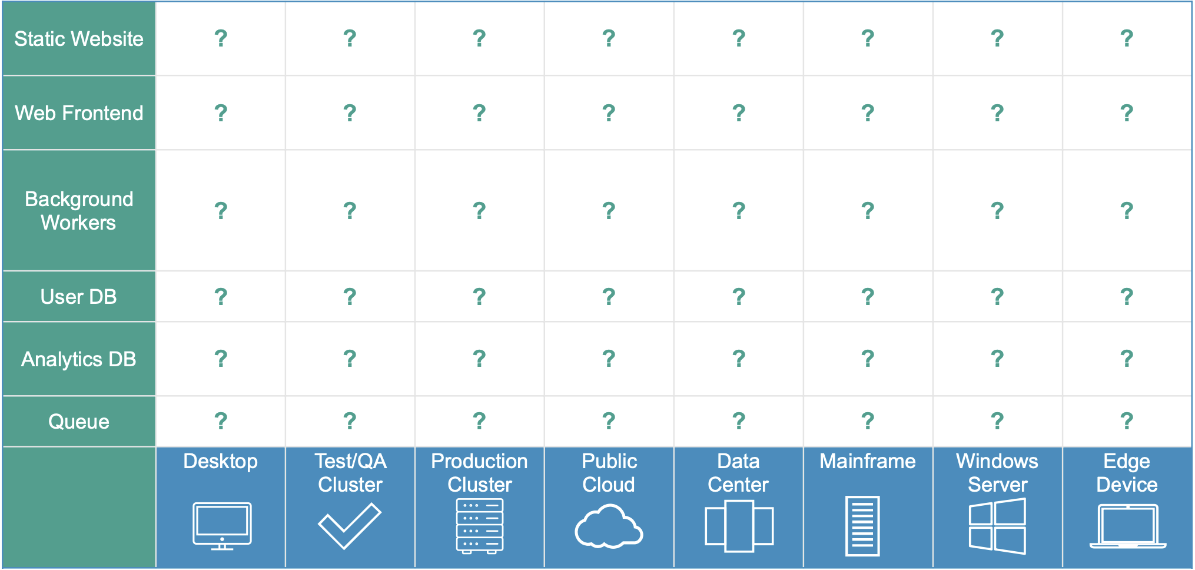
Matrix from hell increases the complexity
Notes:
Matrix of Hell - it is the challenge of packaging any application, regardless of language/frameworks/dependencies, so that it can run on any cloud, regardless of operating systems/hardware/infrastructure.

Slide 8
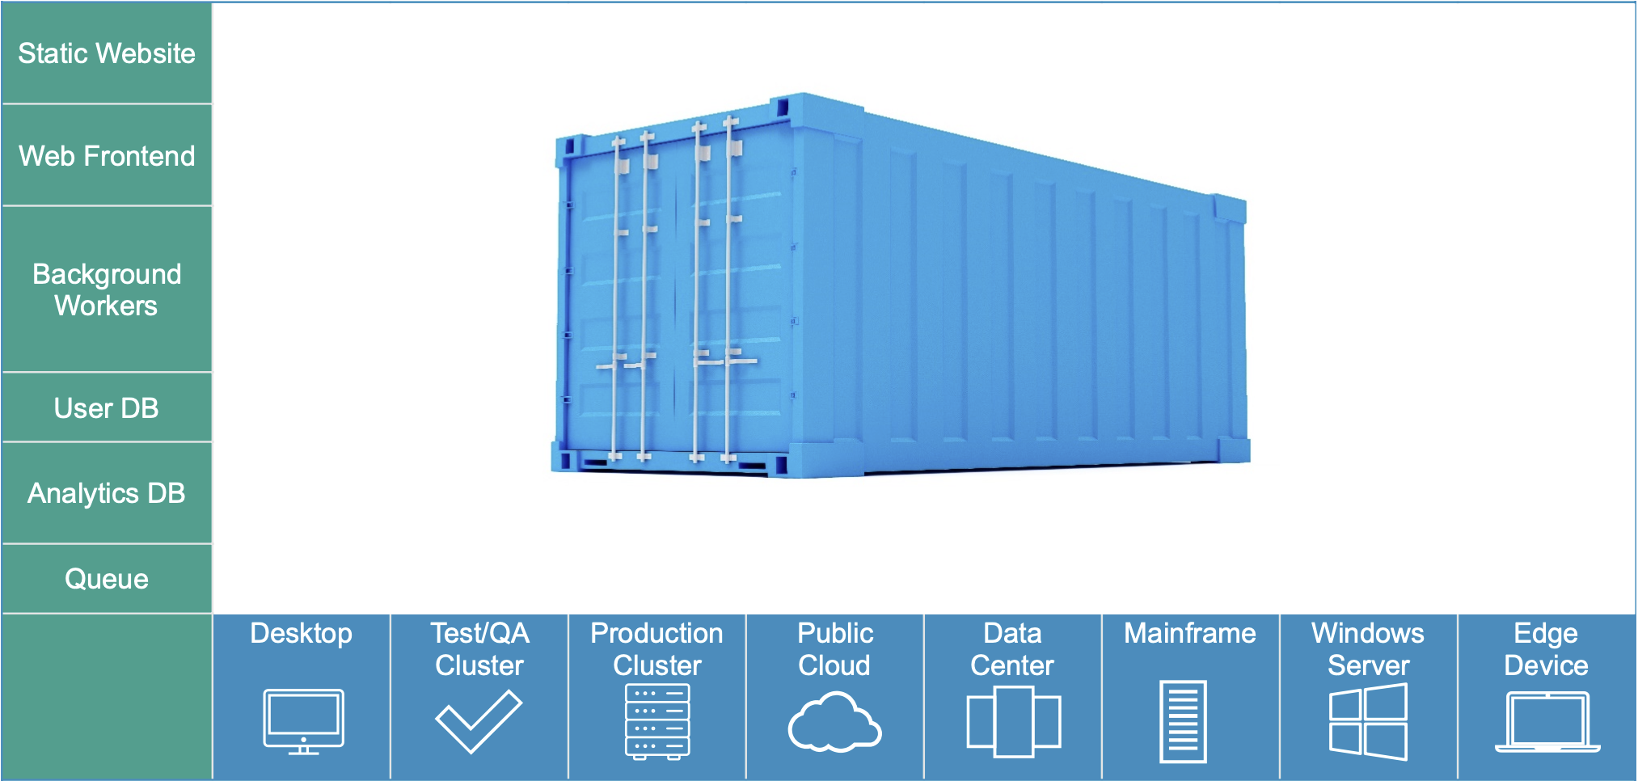
Containers reduces the complexity
Notes:
How containers solves the matrix of hell problem

Slide 9
In summary a container is,
Just an isolated process running on the host machine. And a restricted process.
Will share OS and, where appropriate, bins/ libraries and limited to what resources it can access.
It exits when the process stops.
“Containers are the next once-in-a-decade shift in IT infrastructure and process”
Notes:
After talking about points -->
This isolation of containers processes and limiting to what resources it can access, is done using main two features called namespaces/ cgroups in the linux kernel level. Will talk more on this on upcoming slide
After talking about the slide -->
Containers are more useful in App modernization efforts and micro services as they offer speed, lightweight and portability - advantages of containers over the VMs.

Slide 10
What is docker?

Slide 11
So what’s Docker? – In 2024, Docker means lot’s of things, let’s just clear things out.
Docker as a “Company”
Docker as a “Product”
Docker as a “Platform”
Docker as a “CLI tool”
Docker as a “Computer Program”
Notes:
Started in 2013 – Open soruce project by company called dotnet-cloud. Started a new company called Docker Inc.
When you say Docker, lots of people means lots of things, but on this session we mainly focus on the Docker as a platform. From this point onwards when we mean Docker, we refer to the Docker platform

Slide 12
What is Docker?
Docker provides the ability to package and run applications within a loosely isolated environment which is a a container. Simply it’s a container engine (runtime + tool for managing containers and images).
It provides tooling and a platform to manage lifecycle of your containers,
Develop your apps and supporting components using containers
Distribute and test your apps as a container
Ability to deploy your app as a container or an orchestrated service, in whatever environment which supports Docker installation
It shares the same OS kernel
It works on all major Linux Distributions and containers native to Windows Server (specific versions)
Notes:
Gret UX for developers to interact with containers

Slide 13
Underlying technology in docker
Docker is an extension of LXC’s (Linux Containers) capabilities and packaged it in a way which is more developer friendly.
It was developed in Go language and utilizes LXC, namespaces, cgroups and the linux kernel itself. Docker uses namespaces to provide the isolated workspace called a container. Each aspect of a container runs in a separate namespace and its access is limited to this namespace.
Notes:
Linux kernel provides cgroups that allow the host CPU to better partition memory allocation into isolation levels called namespaces
Docker gives something more on top of LXC to manage and use it more user friendly

Slide 14

Notes:
How docker solves the matrix of hell problem

Slide 15
BASIC DOCKER COMMANDS

Slide 16
Docker CLI structure,
Old (Still works as expected) docker <command> options
New – docker <command> <sub-command> (options)
Pulling Docker Image
docker pull nginx
Running a Docker Container
docker run –p 80:80 --name web-server nginx
Stopping the Container
docker stop web-server (or container id)

Slide 17
Check what’s happening in a containers,
docker container top web-server – Process list in 1 container
docker container inspect web-server – Details of one container config
docker container stats – Performance stats for all containers
Getting a shell inside containers,
docker container run –it – Start a new container interactively
docker container exec –it <container_id_or_name> echo “I’m inside the container” – Run additional commands in the container
Listing, removing containers and images
docker images
docker container ls | docker ps
docker <object> rm <id_or_name>

Slide 18
Are there solutions other than docker?
Docker – Container runtime + Tool for managing containers and images
Containerd – Container runtime only
Podman – Tool for managing containers and images
Notes:
Gret UX for developers to interact with containers

Slide 19
Deep dive into docker internals

Slide 20

Docker architecture
Notes:
Docker uses Client Server Architecture. Docker client talks to the Docker deamon which may run on the same system or can event connect to a remote one Client and deamon communication is done using a REST API, over unix sockets or a network connection Docker deamon (dockerd) – Listens to Docker API req and manages Docker objects (images, containers, networks, volumes). It can also communicate with other deamons to manage services which happens in Docker swarm Docker Client (docker) – primary way of users interacting with Docker. Command scenario. docker command uses Docker API Docker Registry – Stores docker images. Docker Hub is a public one which anyone can use and by default docker checks for images here. There are lot of other options out there and you can even host your own private registry.

Slide 21
What happens when you run a container?
docker run –p 80:80 nginx | docker container run –p 80:80 nginx
Looks for that particular image locally in image cache, if its not found pulls it from the configured registry (image repository). Downloads the latest version by default (nginx:latest)
Creates a new container based on that image and prepares to start
Docker allocates read write filesystem to the container, as its final layer. This allows running container to modify files and directories in its local filesystem.
Gives it a virtual IP on a private network inside docker engine
Opens up port 80 on host and forwards to port 80 in container.
Starts container by using the CMD in the image Dockerfile.

Slide 22
Docker Objects
Docker Images
A read-only template with instructions/ metadata for creating a Docker container.
Can create your own image or use images created and published in a registry by others.
Dockerfile can be used to define steps required to create and run the image.
Each instruction in Dockerfile creates a layer in the image, only those layers which changes each time are rebuilt – What makes images so lightweight, small and fast.

Slide 23
Docker Containers
Runnable instance of an image.
Can create, start, stop, move, or delete a container using the Docker API or CLI.
Can connect it to one or more networks, attach storage to it, or even create a new image based on its current status.
A container is defined by its image as well as any config options provided to it when you create or start it. Note that when the container is removed any data associated with it will be deleted unless those are not stored in a persistent storage.

Slide 24
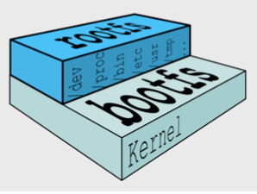
Understanding Docker images/ containers internals
Docker Filesystem
Boot file system (bootfs) – Contains the bootloader and the kernel. User never touches this.
Root file system (rootfs) – Includes the typical directory structure we associate with Unix-like OS.
Notes:
Understanding how things work internally allows allows you to understand why Docker is able to perform more faster and efficient. Plus also note some important points for writing Dockerfiles
After rootfs point →
In Linux and other UNIX like systems everything is based on the Filesystem Hierarchy Standard

Slide 25
In traditional Linux boot, kernel first mounts the rootfs as read-only, checks its integrity, and then switches the rootfs volume to read-write mode.
Docker mounts the rootfs and instead of changing the file system to read-write mode, it then takes advantage of union mounts service to add a read-write filesystem over the read-only file system.
In Docker terminology, a read-only layer is called an image. An image never changes and is fixed.
Each image depend on one more image which creates the layer beneath it. The lower image is the parent of the upper image. Image without a parent is a base image.
When you run a container, Docker fetches the image and its Parent Image, and repeats the process until it reaches the Base Image. Then the Union File System adds a read-write layer on top.
That read-write layer, plus the information about its Parent Image and some additional information like its unique id, networking configuration, and resource limits is called a container
Notes:
Union mounting - UFS is a way of combining multiple directories into 1 that appears to as a all those combined . The Docker storage driver is responsible for stacking these layers (overlay2, aufs etc..)
Images in next slide will help you to understand it better

Slide 26
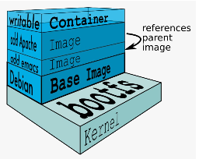
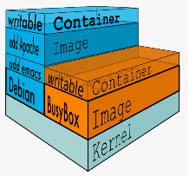
Notes:
You can see the writable layer is the container.
So the only diff between image vs container is the top read/writable layer.
When container is deleted read/writable layer is deleted
Since each container has its own read/writable container layer, this means multiple containers can share access to the same underlying image and yet have their own data sate

Slide 27
A container can have two states, it may be running or exited.
When a container is exited the state of the file system and its exit value is saved.
You can start, stop, and restart a container. The processes of restarting a container from scratch will preserve its file system is just as it was when the container was stopped. But the memory state of the container is not preserved.
You can also remove the container permanently.
A container can also be promoted directly into an image using the docker commit command. Once a container is committed as an image, you can use it to create other images on top of it.
docker commit <container-id> <image-name:tag>

Slide 28
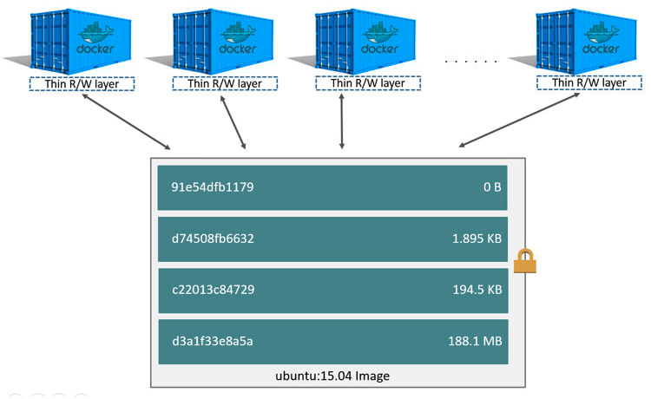
Based from the UFS, Docker uses a strategy called Copy on Write to improve the efficiency by minimizing I/O and the size of each subsequent layers,
If a file or directory exists in a lower layer within the image, and another layer (including the writable layer) needs read access to it, it just uses the existing file.
The first time another layer needs to modify the file (when building the image or running the container), the file is copied into that layer and modified.

Slide 29
Docker Image Creation and Storage
You can create an image using a Dockerfile or by committing a container’s changes back to an image.
Once you create an image, it will be stored in the Docker host’s local image cache.
In order to move images in/out of the local image cache,
Export/ Import it as a tarball
Push/ pull to a remote image registry (ex - DockerHub)

Slide 30
Docker Objects cont…
Docker Networks
Each container is connected to a private virtual network called “bridge”.
Each virtual network routes through the NAT firewall on the host IP.
All containers on a virtual network can talk to each other without exposing ports.
Best practice is to create a new virtual network for each app.

Slide 31
Docker enables to:
Create new virtual networks.
Attach container to more than one virtual network (or none)
Skip virtual networks and use host IP (--net=host)
Use different Docker network drivers to gain new abilities.
Docker Engine provides support for different network drivers – bridge (default), overlay and macvian etc.. . You can even write your own network driver plugin to create your own one.
Docker Networking – DNS
Docker deamon has a built in DNS, which consider container name as equivalent hostname of the container.
Notes:
Bridge network – Default one, containers are by default deployed here limited to a single host running Docker Engine.
Overlay Network - An overlay network can include multiple hosts

Slide 32
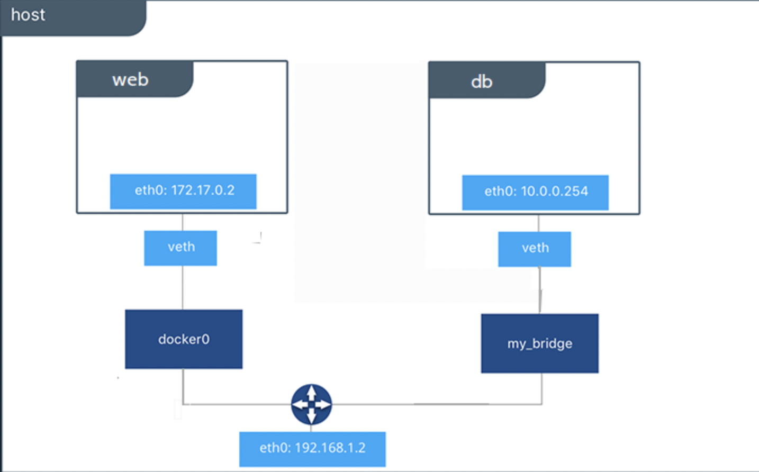
Notes:
Docker0 is the default bridge network, you can even create your own networks

Slide 33
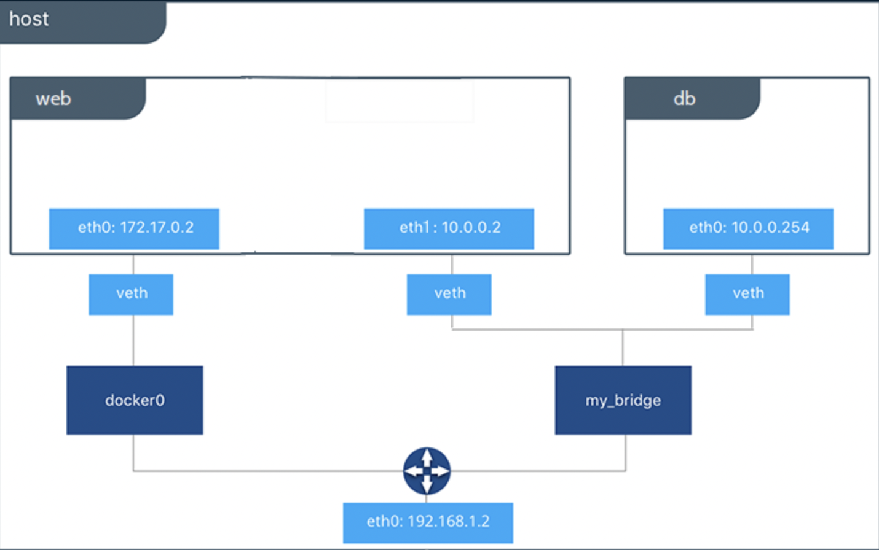
Notes:
Docker networking allows you to attach a container to as many networks as you like. You can also attach an already running container.

Slide 34
persistence data
If we want to use persistence data as in like databases or unique data in containers, Docker enables that using two ways,
Volumes – Make a location outside of container UFS.
Bind Mounts - Link host path to the container path.

Slide 35
Docker compose
Another Docker client, that lets you work with apps consisting of a set of containers.
This saves docker container run settings in easy to read file, which can be committed to VCS.
Can use this to create one-line development environments
Consists of two components
YAML formatted file that describes – Images, Containers, Networks, Volumes etc…
A CLI tool docker-compose used to automate/manage those YAML files
Notes:
I won’t cover Docker Swarm on this session as it comes under container orchestration. I felt that it will drag this session as we have a demo session planned. But in simple SWARM is a container orchestration solution which allows you to manage multiple containers deployed across multiple host machines. Bit simillar to K8’s but less complex which means can’t extend into the levels we see with K8’s. Begineer friendly.

Slide 36
Docker buildKit & buildx
BuildKit enables higher performance docker builds and caching possibility to decrease build times and increase productivity for free. (https://github.com/moby/moby)
Standard docker build command performs builds serially, which means reads and builds each line or layer of the Dockerfile one layer at a time. With Buildkit enabled, it allows for parallel build processing resulting in better performance and faster build times.
It also enables the use of cache and storing cache in remote container repositories like DockerHub for better build performance as we don't have to rebuild every layer of an image.
You can enable BuildKit in places you already uses docker build including within your CI/CD pipelines to reduce the build times.
Notes:
Moby project is an open framework created by Docker Inc. to assemble specialized container systems without reinventing the wheel.

Slide 37
Docker buildKit & buildx cont…
Docker Buildx is a CLI plugin that extends the docker command with the full support of the features provided by BuildKit plus additional features. (Included within Docker Desktop versions & Docker Linux packages. You can even download as a source from Github)
Features of buildx,
Familiar UI from docker build
Full BuildKit capabilities with container driver
Multiple builder instance support
Multi-node builds for cross-platform images
High-level build constructs (bake)
Notes:
Multi-node builds for cross-platform images – Before version 19.03 building multi platform images required you to manually create manifest files and build images separately. With Buildx, all these are included and allows you to create multi-platform images
Building multi platform images will comes in handy if you are an image publisher and requires to build images for multiple architectures, like for raspberry-pi with linux/arm/v7 | v8 or other archs like linux/amd64, linux/arm64. The bake command supports building images from compose files, similar to docker-compose build, but allowing all the services to be built concurrently as part of a single request.

Slide 38
Docker buildKit & buildx performance
Case | Classic Builder | BuildKit + buildx
Dependency Change | 6 min | 6 min
Code Change | 6 min | 3 min
No Change | 6 min | 1 min
Jiang Huan BuildKit timings (Look for references section)
Notes:
All in all these are bit advanced features. I added this specifically to talk about creating multi-platform images and performance improvements you get with BuildKit. These are not features you will use upfront when starting with Docker, but just wanted to point out theses features exists for you to look into and use to optimize.
Will do a simple demo on this section. But I invite you to read about this and try this out and then you can use it in prod with confidence. Refer the reference section

Slide 39
Demo
Running/ Stopping/ Removing a NGINX container using Docker CLI
Building/ Running/ Shipping a NodeJS app with Docker
Running multi-component app with Docker Compose
Buildx demo with BuildKit – Multi-platform image creation
Notes:
Demo uses basic versions, just to showcase the capabilities. To know more I invite you to read the documentation and try out new things. Best way to learn

Slide 40
How can we run containers at scale?

Slide 41
Container orchestration
Container orchestration automates the deployment, management, scaling, and networking of containers.
Container orchestration can be used in any environment where you use containers. It can help you to deploy the same application across different environments without needing to redesign it.

Slide 42
Introduction to docker swarm

Slide 43
Docker swarm key concepts
Docker Swarm provides the cluster management and orchestration features of Docker Engine 1.12
Nodes - A node is an instance of the Docker engine participating in the swarm. You can also think of this as a Docker node.
Manager Node - To deploy your application to a swarm, you submit a service definition to a manager node. These nodes are also responsible for perform the orchestration and cluster management functions required to maintain the desired state of the swarm.
Worker Nodes - Receive and execute tasks dispatched from manager nodes. An agent which is running within the worker nodes report the current status of the tasks assigned to it which allows manager node to keep the desired state for each worker node.

Slide 44
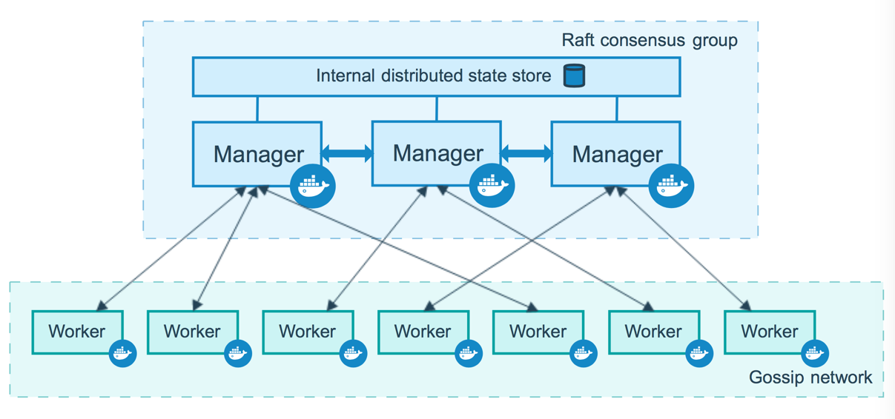

Slide 45
Task - It is the atomic scheduling unit of swarm. Manager nodes assign tasks to worker nodes according to the number of replicas set in the service scale.
Service - the definition of the tasks to execute on the manager or worker nodes. Here is where you specify which container image to use and which commands to execute inside running containers.
Replicated services model - the swarm manager distributes a specific number of replica tasks among the nodes based upon the scale you set in the desired state.
Global services model - the swarm runs one task for the service on every available node in the cluster.

Slide 46
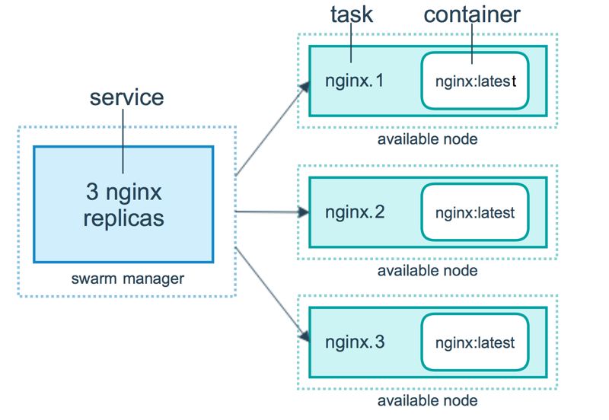

Slide 47
docker swarm init --advertise-addr <MANAGER-IP>
Join a worker node - docker swarm join --token SWMTKN-1 49nj1cmql0jkz5s954yi3oex3nedyz0fb0xx14ie39trti4wxv-8vxv8rssmk743ojnwacrr2e7c 192.168.99.100:2377
docker service create --replicas 1 --name helloworld alpine ping docker.com
docker service scale <SERVICE-ID>=<NUMBER-OF-TASKS>

Slide 48
Introduction to kubernetes

Slide 49
What is kubernetes?
“Kubernetes (k8s) is an open source platform for automating deployment, scaling and management of containers at scale”
Project that was created by Google as an open source container orchestration platform. Born from the lessons learned and experiences in running projects like Borg and Omega @ Google
It was donated to CNCF (Cloud Native Computing Foundation) who now manages the Kubernetes project
Current Kubernetes stable version – 1.29

Slide 50
It’s capable of…
Horizontal scaling
Load distribution
Service discovery
Health monitoring
Deploying new versions, rollbacks
Handling hardware faliures

Slide 51
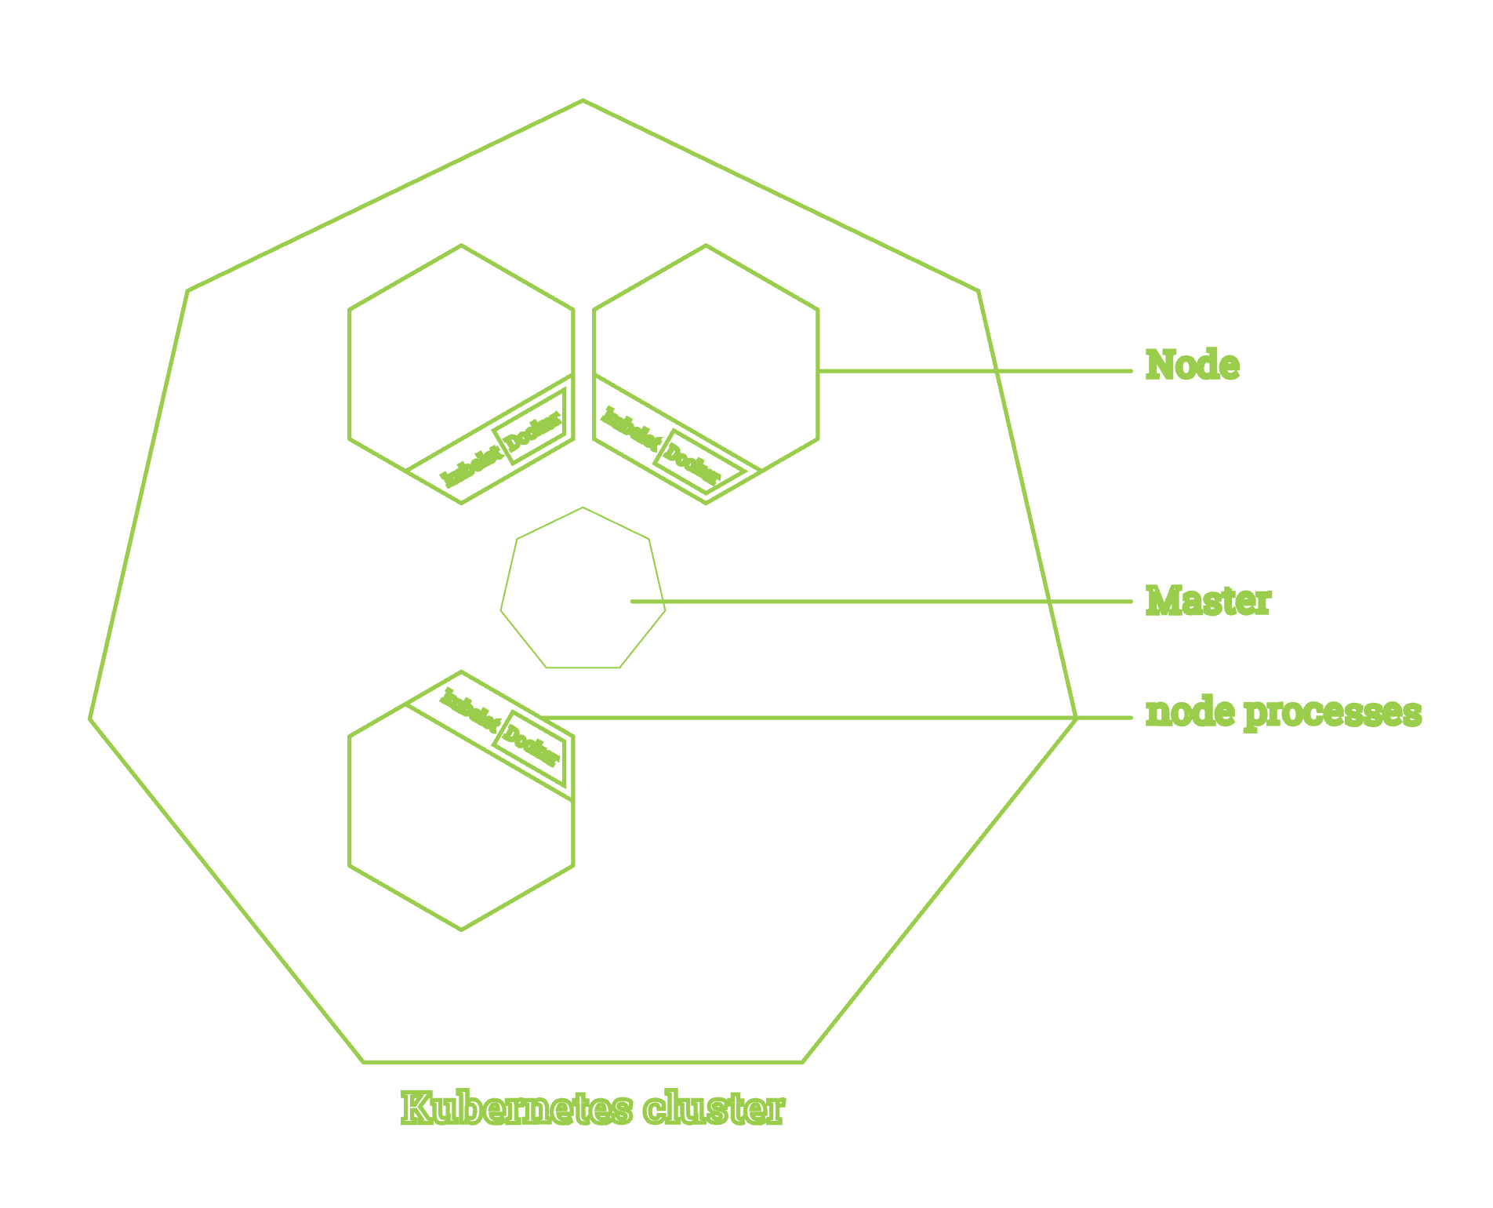
High level Architecture
Master [Control Plane]
coordinates all activities in the cluster
Nodes:
virtual or physical machines
actual workers
runs processes:
kubelet
kube-proxy
container runtime

Slide 52
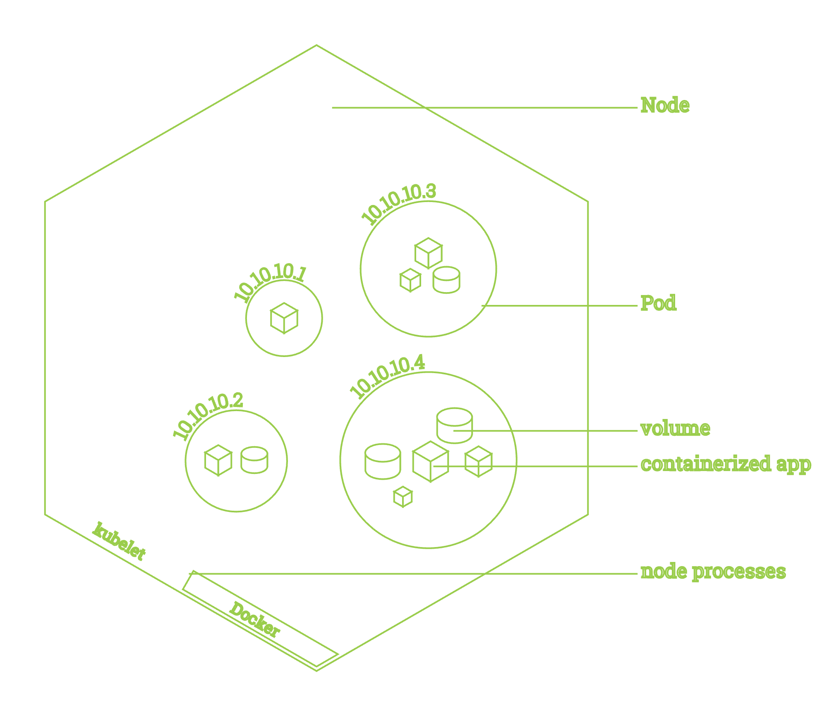
Basic building blocks
Containers
Define single running process*
Eg docker container
Pods
the way of running containers in kubernetes
basic deployable and scaling unit
defines one or more containers
containers are co-located on a node
flat network structure
Nodes:
physical worker machines
can run multiple pods
pods running within single node don’t know about each other

Slide 53
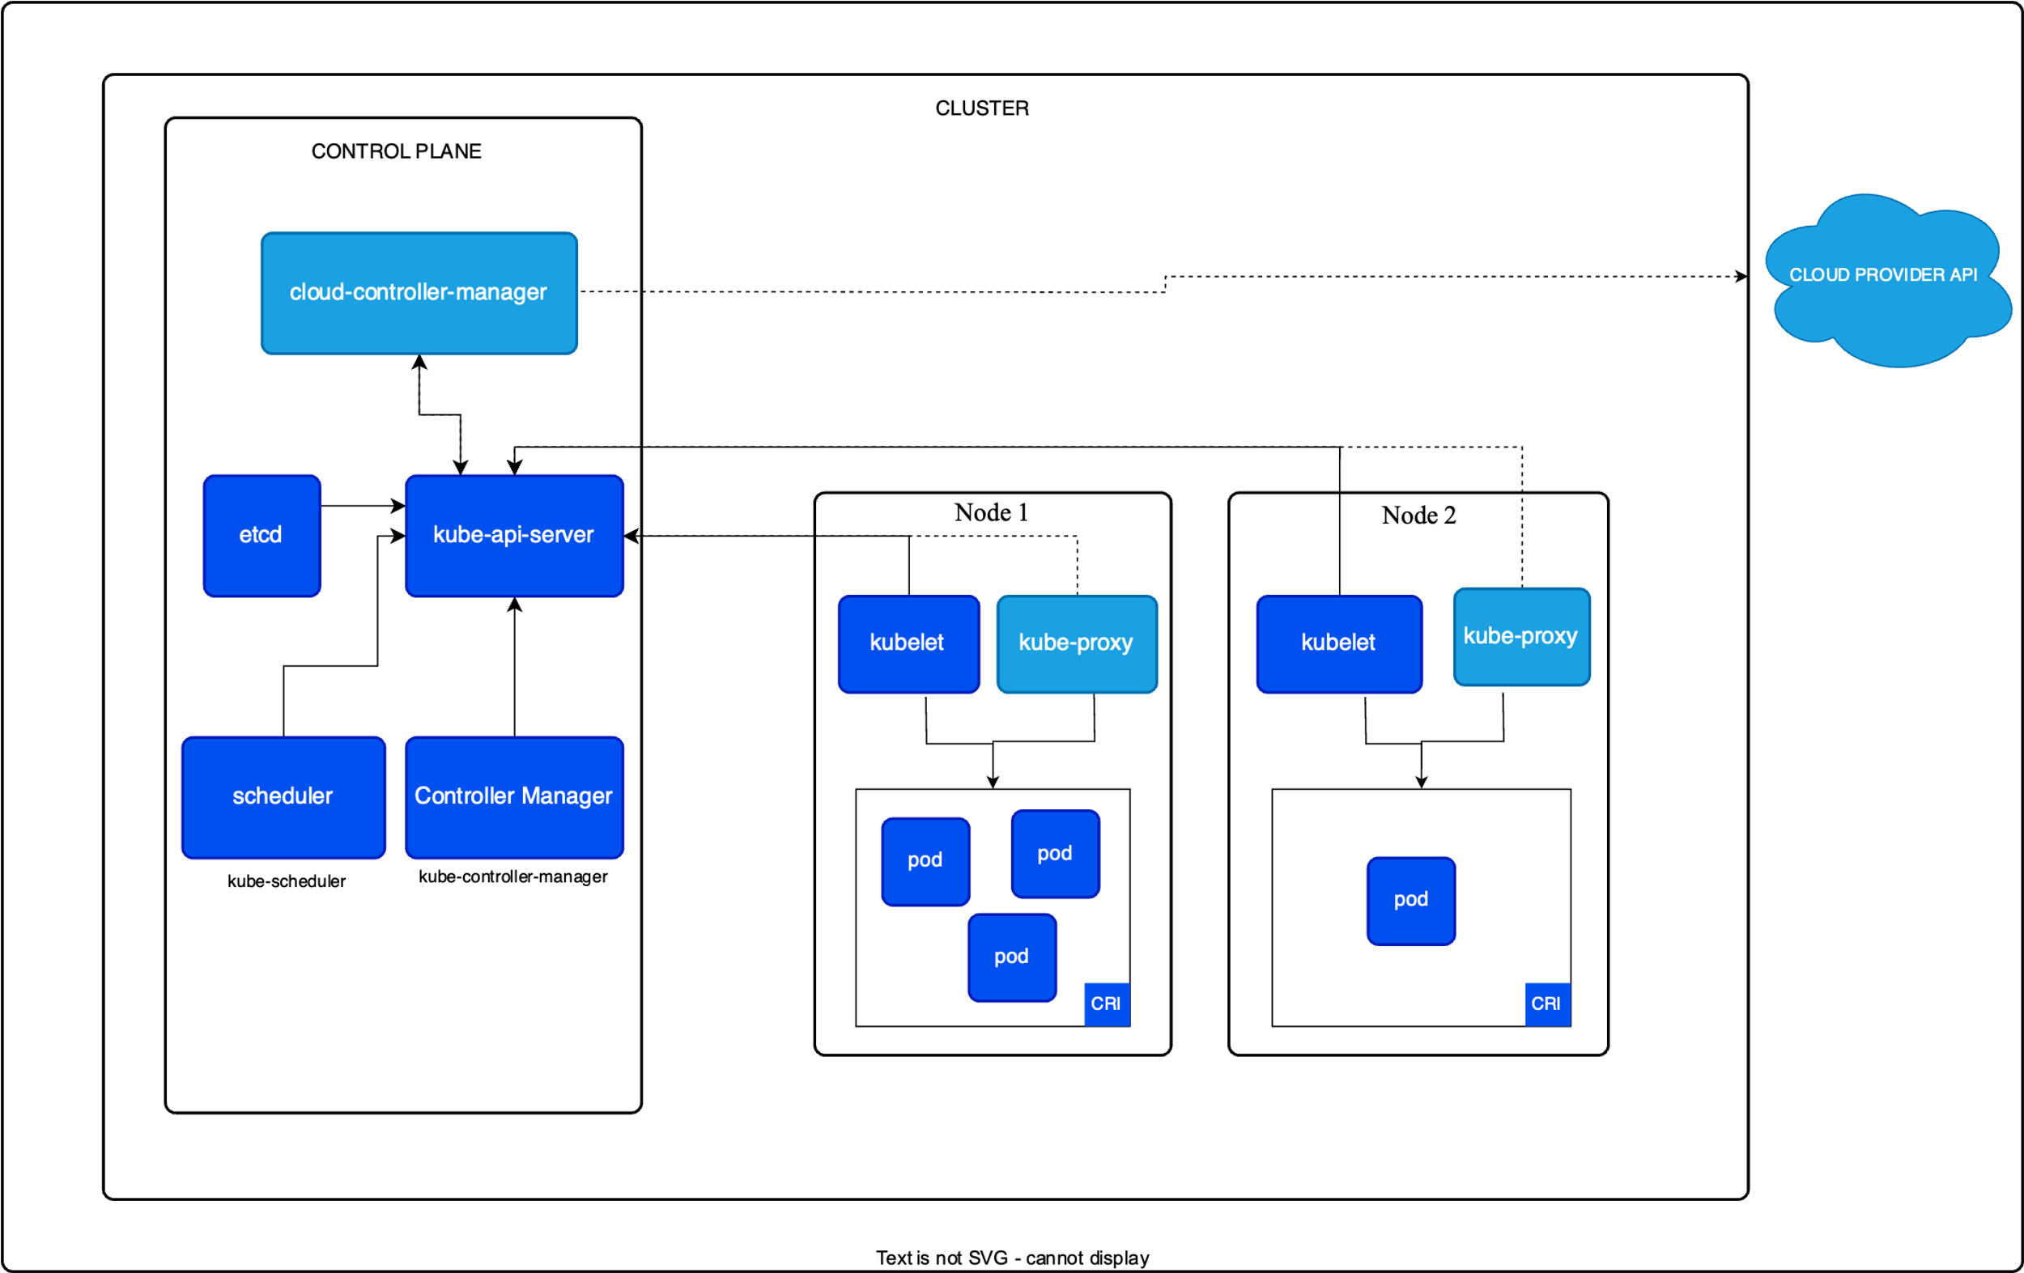

Slide 54
Running things locally
Minikube:
single node cluster
running in a VM
supports linux, windows and macOS
mature project
Docker Desktop with built-in kubernetes:
single node cluster
running in a VM
windows and macOS
drag & drop installation
bound to specific kubernetes version
kind:
Requires you to have Docker or Podman installed in your local computer
https://kubernetes.io/docs/tasks/tools/

Slide 55
Managing cluster resources
Create resource from file - kubectl create -f resource_file.yml
Change existing (or create) resource based on file - kubectl apply -f resource_file.yml
Delete existing resource - kubectl delete resource_type resource_name
List resources of type - kubectl get resource_type
Edit resource on the server - kubectl edit resource_type resource_name

Slide 56
Debugging cluster resources
Execute command on the container - kubectl exec [-it] pod_name process_to_run
Get container logs - kubectl logs pod_name [-c container_name]
Forward port from a pod - kubectl port-forward pod_name local_port:remote_port
Print detailed description of a resource - kubectl describe resource_type resource_name

Slide 57
Few resource objects in k8s
Replica Sets - Ensures desired number of pods exist by: scaling up or down and running new pods when nodes fail
Deployment
A Deployment provides declarative updates for Pods and ReplicaSets. You describe a desired state in a Deployment, and the Deployment Controller changes the actual state to the desired state at a controlled rate.
Service
A method for exposing a network application that is running as one or more Pods in your cluster.
Cluster IP/ NodePort/ Load Balancer/ Ingress
Notes:
Cluster IP - ClusterIP is the default service that enables the communication of multiple pods within the cluster. By default, your service will be exposed on a ClusterIP if you don't manually define it. ClusterIP can’t be accessed from the outside world. But, a Kubernetes proxy can be used to access your services.
NodePort - simply routes traffic on a random port on the host to a random port on the container.
LoadBalancer - It is a standard load balancer service that runs on each pod and establishes a connection to the outside world, either to networks like the Internet, or within your datacenter. The LoadBalancer will keep connections open to pods that are up, and close connections to those that are down. This is similar to what you have on AWS with ELBs, or Azure with Application Gateway. Upstreams provide Layer 4 routing for HTTP(S) traffic, whereas Downstreams provide Layer 7 routing for HTTP(S) traffic.
Ingress - An Ingress is a Kubernetes object that sits in front of multiple services and acts as an intelligent router. It defines how external traffic can reach the cluster services, and it configures a set of rules to allow inbound connections to reach the services on the cluster.

Slide 58
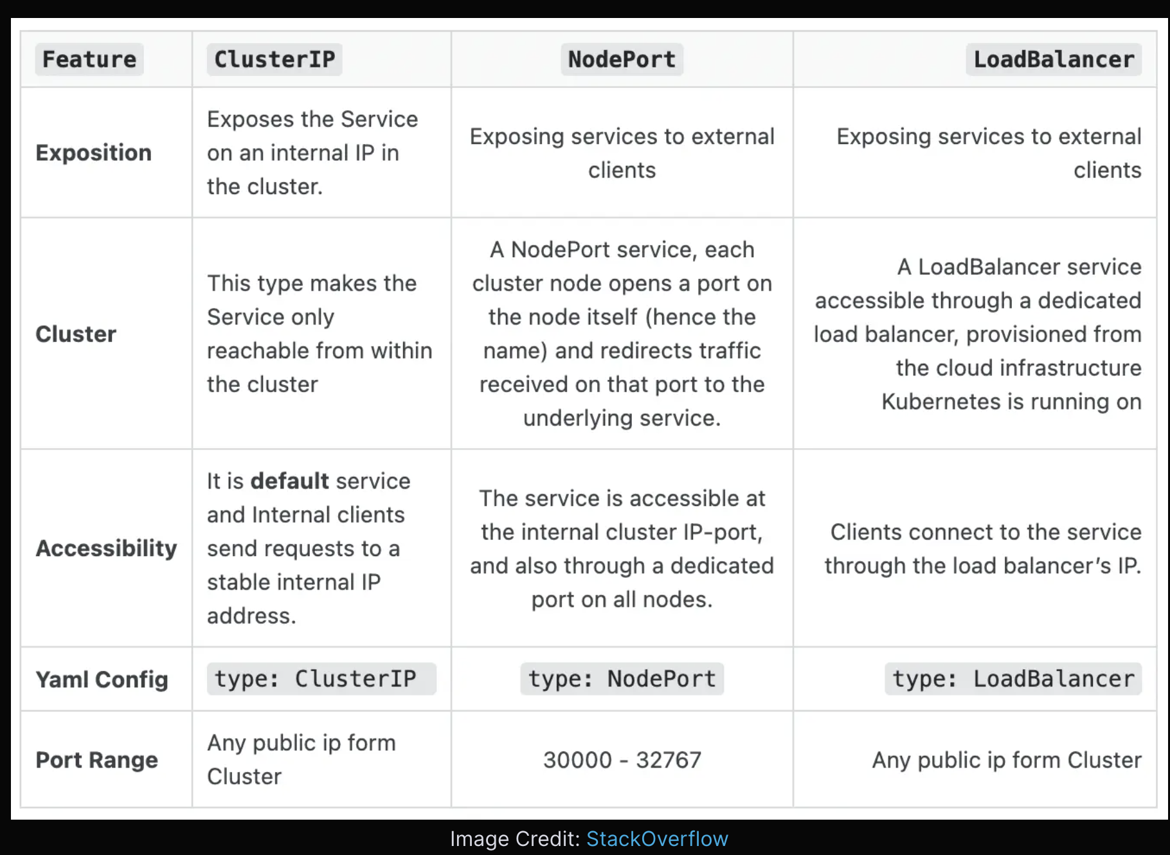
Notes:
Cluster IP - ClusterIP is the default service that enables the communication of multiple pods within the cluster. By default, your service will be exposed on a ClusterIP if you don't manually define it. ClusterIP can’t be accessed from the outside world. But, a Kubernetes proxy can be used to access your services.
NodePort - simply routes traffic on a random port on the host to a random port on the container.
LoadBalancer - It is a standard load balancer service that runs on each pod and establishes a connection to the outside world, either to networks like the Internet, or within your datacenter. The LoadBalancer will keep connections open to pods that are up, and close connections to those that are down. This is similar to what you have on AWS with ELBs, or Azure with Application Gateway. Upstreams provide Layer 4 routing for HTTP(S) traffic, whereas Downstreams provide Layer 7 routing for HTTP(S) traffic.
Ingress - An Ingress is a Kubernetes object that sits in front of multiple services and acts as an intelligent router. It defines how external traffic can reach the cluster services, and it configures a set of rules to allow inbound connections to reach the services on the cluster.

Slide 59
demo
Defining a Pod
Creating a ReplicaSet
Creating a Deployment
Creating a Service and exposing it

Slide 60
Q/A

Slide 61
references
https://docs.docker.com/get-started/overview/
https://www.docker.com/blog/containers-and-vms-together/
https://www.redhat.com/en/topics/containers/containers-vs-vms
Docker Storage Drivers - https://docs.docker.com/storage/storagedriver/
https://docs.docker.com/storage/storagedriver/select-storage-driver/
https://www.youtube.com/watch?v=cjXI-yxqGTI
Docker Buildx - https://docs.docker.com/buildx/working-with-buildx/
Jiang Huan BuildKit timings - https://medium.com/titansoft-engineering/docker-build-cache-sharing-on-multi-hosts-with-buildkit-and-buildx-eb8f7005918e
What is Docker BuildKit - https://brianchristner.io/what-is-docker-buildkit/

Slide 62
Thank you!
LinkedIn - https://lk.linkedin.com/in/ravindufernando

